Slide 1
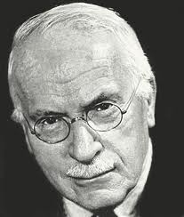
Carl Gustav Jung
Chapter 16

Slide 2
Jung’s theory of personality development: an overview
Neo-Freudian theory (contemporary of ??????)
Social-emotional focus (similar to Erikson v. the psychosexual focus of Freud)
Key stage of life = adulthood (midlife) v. Erikson’s focus on adolescence
Idea of determinism present in Jung’s theory
Personality theory speaks to the “I” (so reinforces Western, individualistic notions)

Slide 3
Two Stages of Development
1. Birth – 40 years (external development; our ‘mask’)
2. 40 + (internal development; focus on our ‘shadow’)
Don’t hold on to past accomplishments
Q. Midlife Crisis??
(NO)

Slide 4
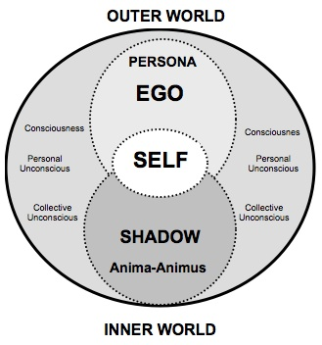
Personality components: our psyche
Ego: conscious awareness of self and world
Persona: ego’s mask (“our image”
The Shadow: things we keep hidden (often negative, or perceived negatively by society) --part of our polarities like our
Anima-Animus: feminine and masculine attributes
Self: who we are. The self gives us our inner urge to balance our various parts and to bring wholeness to our self and meaning to our life.
*psyche: sum total of our conscious and unconscious personality

Slide 5
Personality components,cont.
Personal unconscious: unique to the individual --feelings we have repressed in our lives (the shadow resides here, as may our anima or animus)
Collective unconscious:
innate energy we share with all other humans
Exists at deepest level of psyche
The collective unconscious gives us our archetypes (Examples of archetypes: the wise old woman or man; earth mother; trickster--
we symbolize these in various ways as characters in literature and movies, images in art, symbols in oral traditions (within a given culture and across cultures)

Slide 6
Test your archetypes
https://www.psychologistworld.com/tests/jung-archetype-quiz.php

Slide 7
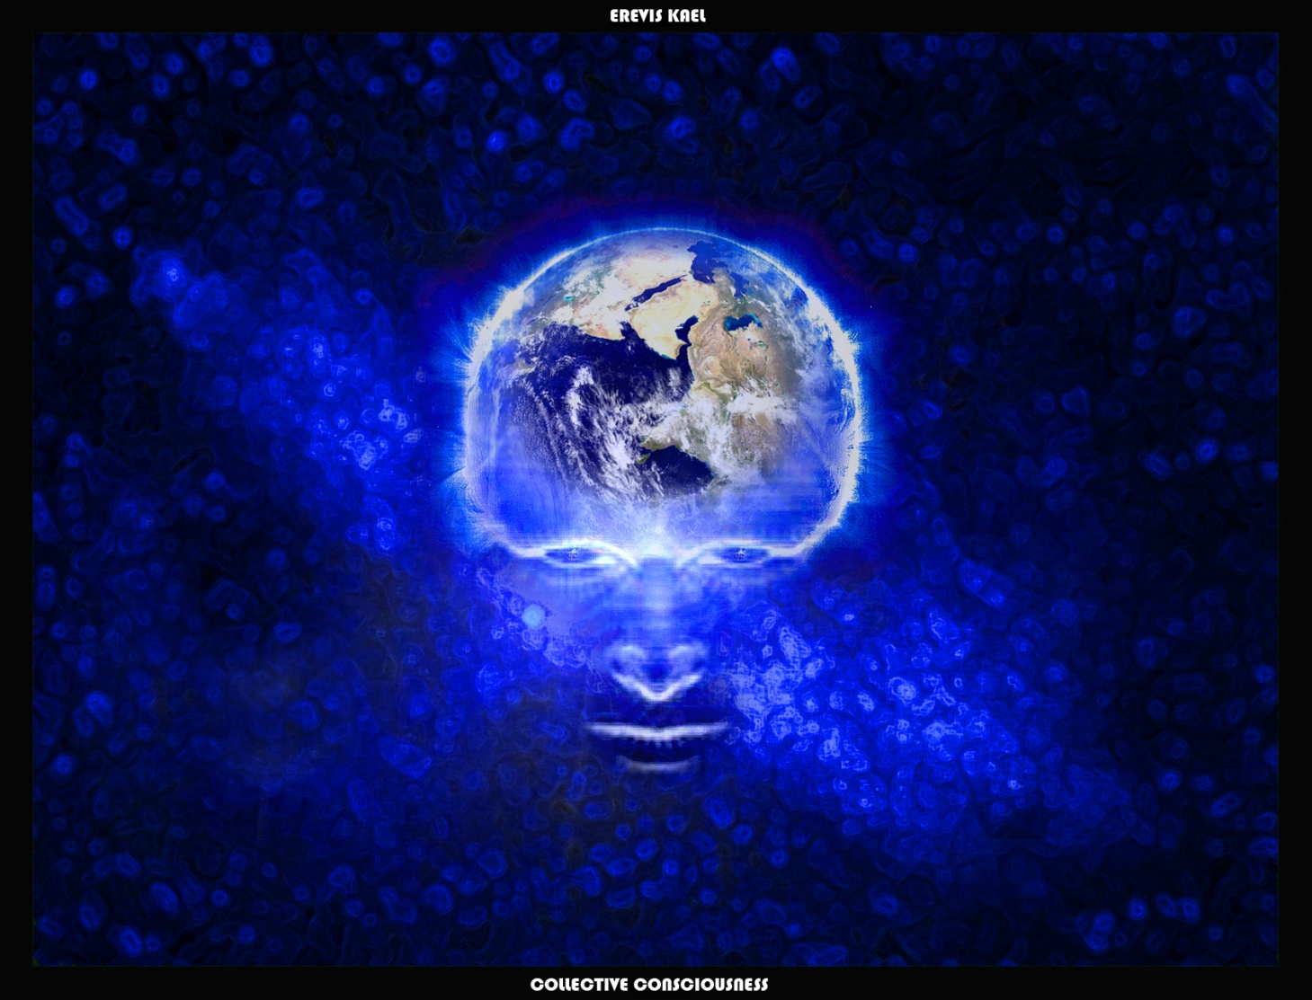
Archetypes: Humans share a collective consciousness
Anima-Animus explored (*You can stop watching at 2:35)
http://www.youtube.com/watch?v=ZN47s0mPfRU

Slide 8
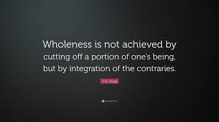
The self includes the polarities of our personality
SHADOW(hidden elements) ----------PERSONA (conscious mask)
anima----------------animus
introvert------------extravert
Must recognize and blend these polarities to achieve wholeness, or ‘individuation’ (Jung)

Slide 9
Q. How can we achieve individuation?
…By exploring facets of ourselves that we’ve repressed in our unconscious
Q. How do we accomplish this????
A. By analyzing our dreams-- Gateway to unconscious is DREAMS
Archetypes are often represented in our dreams --must figure out their significance in our lives

Slide 10
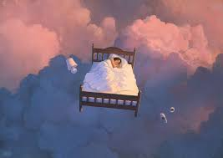
Dream symbols… and their meaning
http://mentalfloss.com/article/55442/12-common-dreams-and-what-they-supposedly-mean

Slide 11
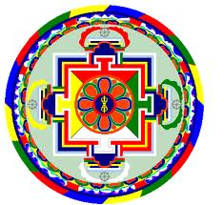
Jung’s vocabulary
1. Psychosis:
loss of contact with reality, usually including false beliefs about what is taking place or who one is (delusions) – comes from lack of individuation
2. Mandala:
symbolic figures of life and wholeness; place in the universe
https://www.youtube.com/watch?v=IYVcjFhpsHc
3. Psychic powers (ESP)

Slide 12
Jung’s concerns w/ society
1. Western culture emphasizes power & materialism – neglects spirituality
*** result = psychosis
2. Society often encourages us to perform certain social roles based on gender, age, etc. -- the result may be to project negative and/or shadow sides onto others, and to not find inner wholeness
3. Individuation can be lost in the socialization process
(what other theorist does this sound like?)
Q. Formula for personal change?
A. Work to achieve individuation by tapping into our unconscious and by blending elements of our personality

Slide 13
Jung’s concerns with society

Slide 14
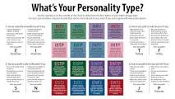
Extras: Popular application of Jung’s personality theory
1. Personality tests: Myers Briggs
Test yours..
https://www.123test.com/jung-personality-test/
http://www.humanmetrics.com/cgi-win/jtypes2.asp
2. Branding:
http://www.proprofs.com/quiz-school/story.php?title=know-your-brand-types_1
3. Self-help books…

Slide 15
Inspirational quote…
“Who looks outside, dreams; who looks inside awakes.” C. G. Jung

